Slide 1
Dynamic Portfolio Optimization
Performance and Evaluation

Slide 2
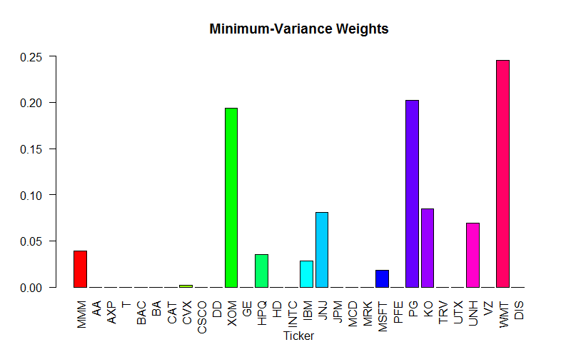
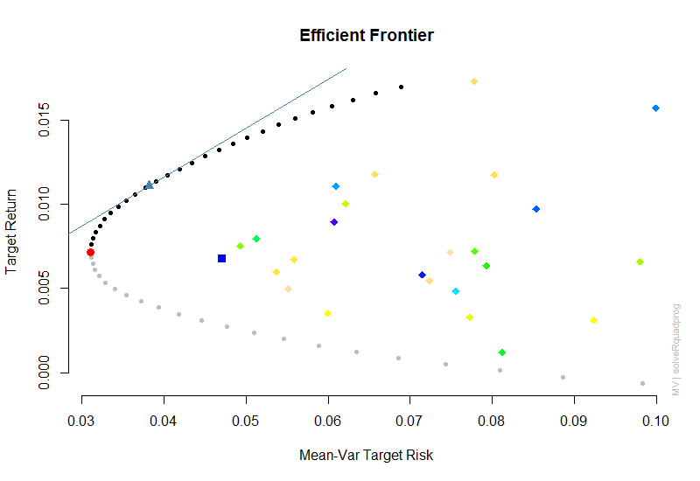
What?

Slide 3
Risk Stable Portfolio
Target the maximum return for a given level of risk
Advantages
It is unambiguously passive
There is no bet on the relative performance between the assets, risk is the only parameter of concern

Slide 4
Asset Classes
Equities
Fixed Income
Corporate Bonds
US Bonds
Real Estate
Commodities
Consumption driven demand
Investment driven demand
Asset: property owned by a person or company, regarded as having value and available to meet debts, commitments, or legacies
i.e. Assets have a positive expected value

Slide 5
Performance of Asset Class Proxies

Slide 6
Asset Class Correlations

Slide 7
Capital Flows
Safety Asset
Long-Term U.S. Debt
Investment Asset
Equities
Less Risk
More Risk

Slide 8
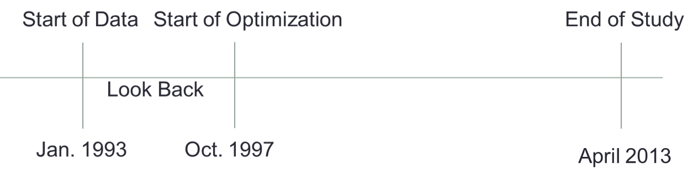
Methodology Part I
Use the previous 2500 daily observations too estimate the GARCH(1,1) model
Then use the one step ahead forecast of the GARCH(1,1) model to estimate the portfolio CVaR for each weight combination in 1% increments
Re-optimize and rebalance every 60 days (Aprox. 1 quarter)
Jan. 1988
Nov. 1997
Jul. 2014

Slide 9
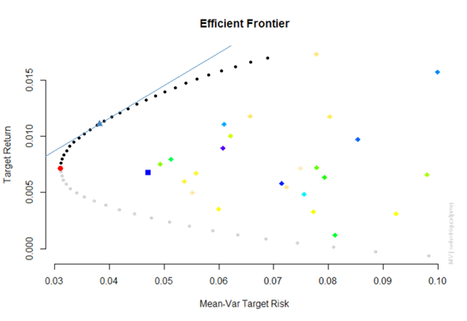
Methodology Part II
Bound the weights for each asset between 10% and 90%
Choose from just two assets; VUSTX & The S&P 500
81 possible weight combinations
VUSTX is a Vanguard mutual fund that tracks Long-Term Government Debt
Further bound the equity weight to be greater than the GMC (Global-Minimum CVaR) Portfolio to ensure the portfolio is on the efficient frontier
Choose the portfolio within the weight bounds that most closely matches the desired CVaR, which is 1%

Slide 10
Methodology Part III

Slide 11
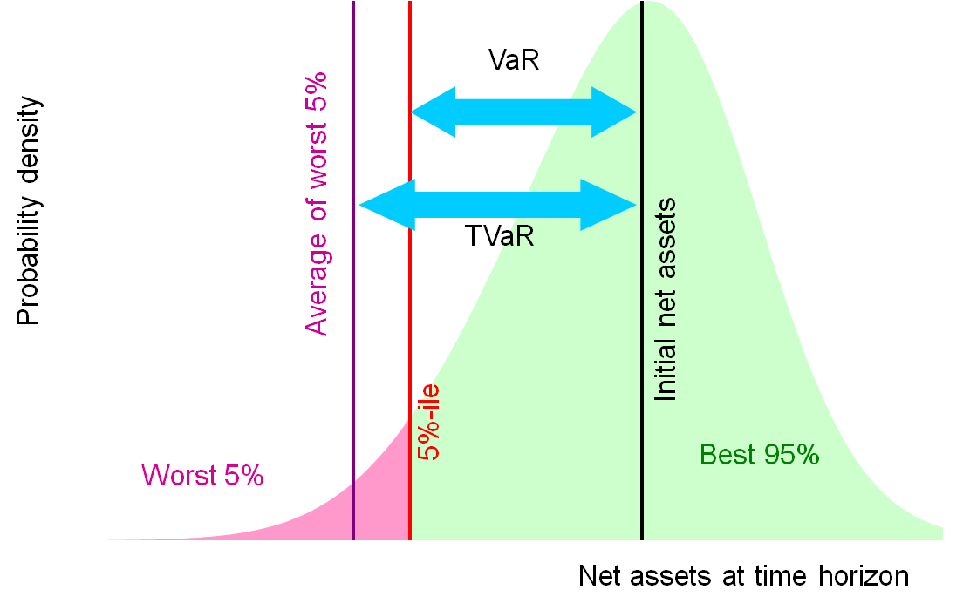
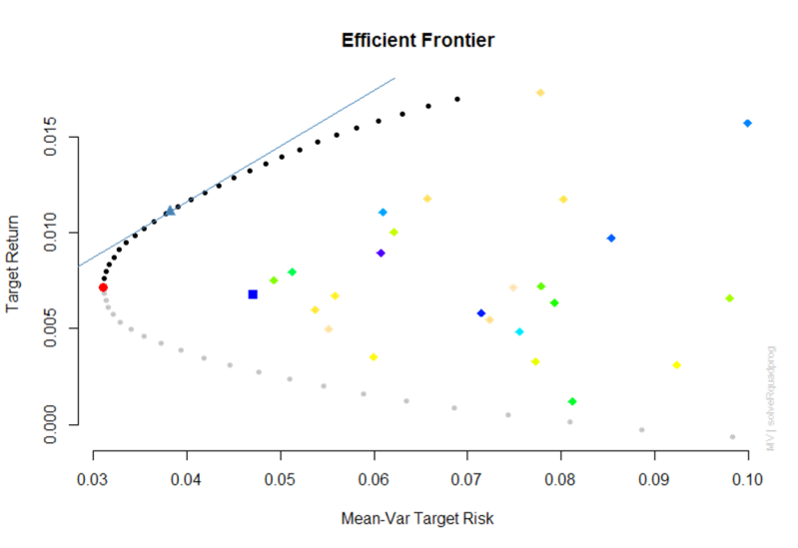
Why CVaR?
Better estimate of risk than volatility
Coherent Risk Measure
Normalized
Monotonicity
Sub-additivity
Positive Homogeneity
Translation Invariance

Slide 12
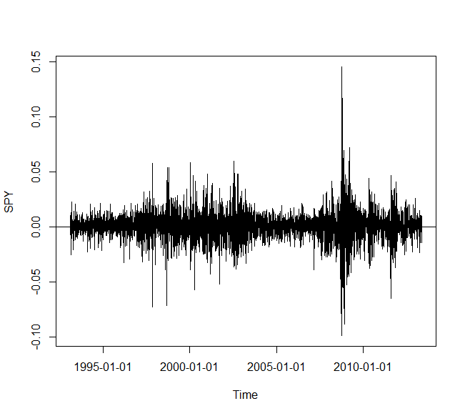
Why GARCH(1,1)?

Slide 13
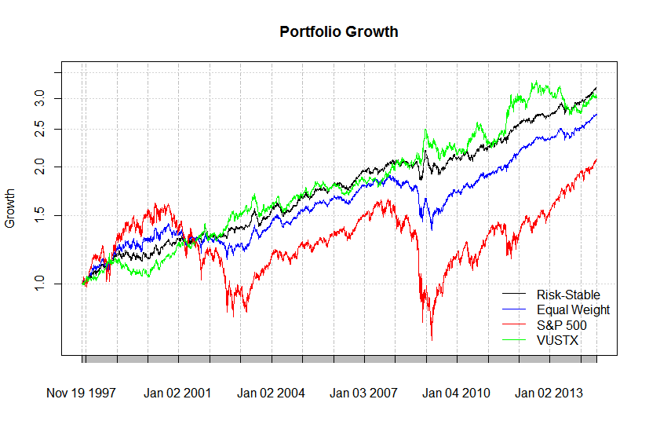
Growth

Slide 14
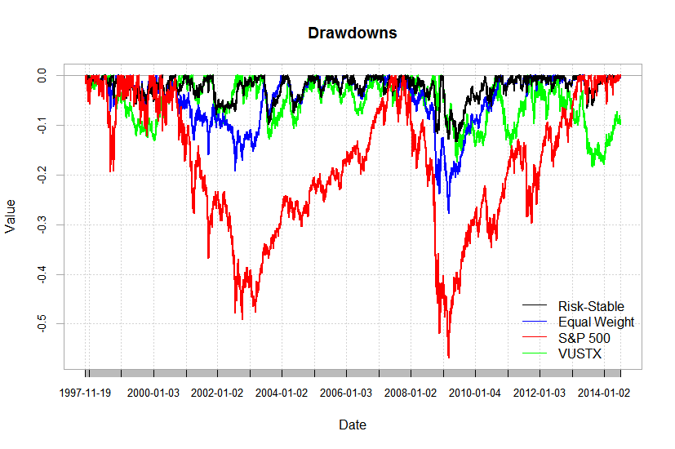
Drawdowns

Slide 15
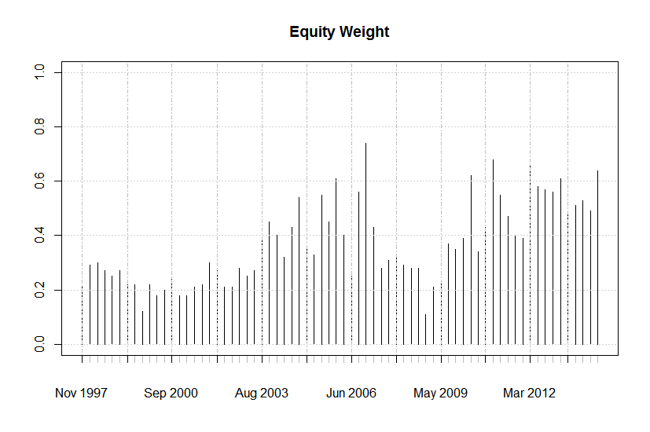
Weights

Slide 16
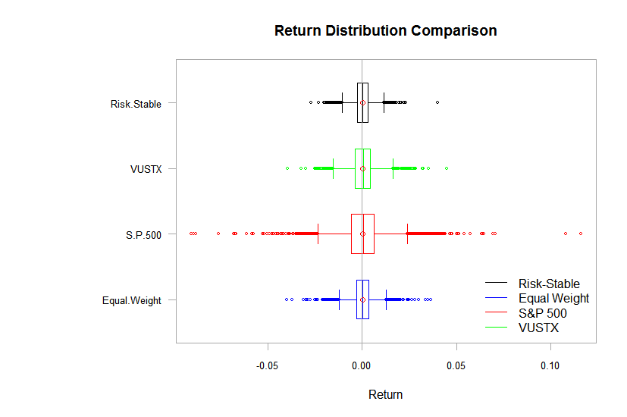
Box Plots

Slide 17
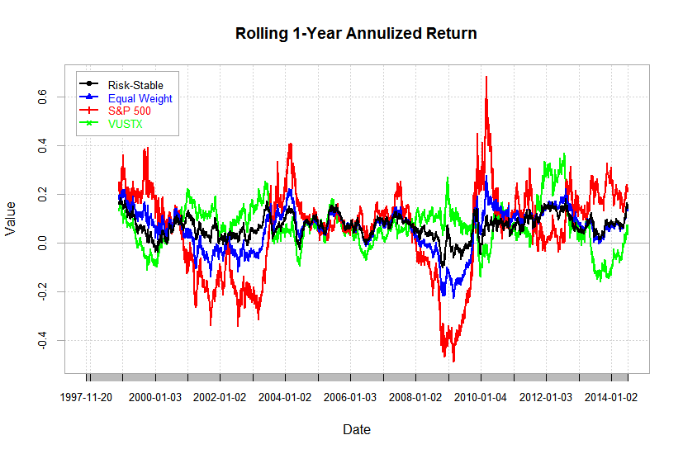
Rolling Return

Slide 18
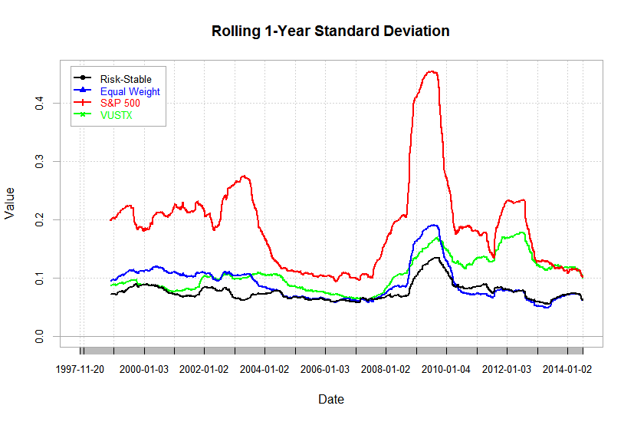
Rolling Volatility

Slide 19

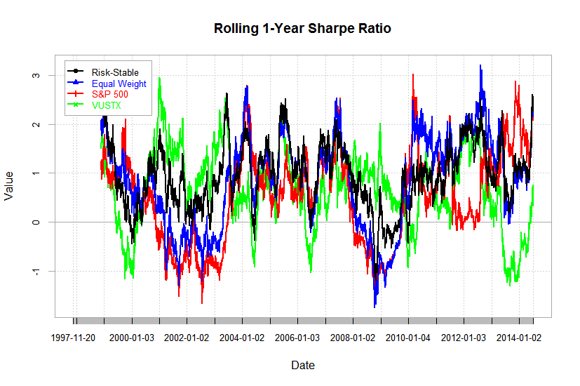
Rolling Sharpe

Slide 20
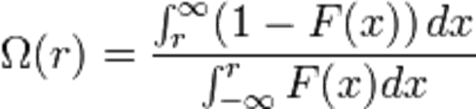
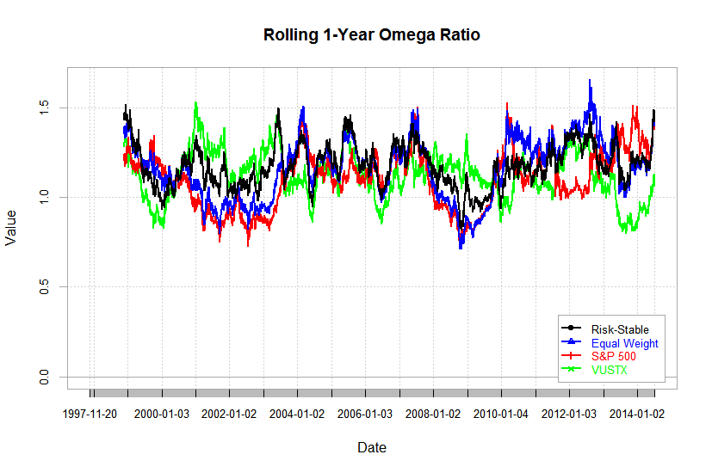
Rolling Omega

Slide 21
Proof of Concept
Can be generalized to N assets, but the computational requirement grows exponentially
Risk-stable portfolios can be actively managed within risk targets by maximizing the portfolio beta for the given level of targeted risk
Advantages:
GARCH Model accounts for volatility clustering
CVaR estimates are a more mathematically correct definition of risk
Historical analysis shows outperformance
The portfolio risk can be actively managed

